Slide 1





Eye-tracking for Diagnosis of Visual Deficits
Sidhant raje
Jerry Zhang
Supervisor: Dr Luke hallum
Part IV Research Project 2019

Slide 2
Research intent
Existing methods for detection of visual deficits
Lack of quantitative measures
Subjective
Manual
Expensive
Application of technology in diagnosis
Computer-based systems can increase accessibility to testing
Automated
Portable
Enable quantitative analysis for diagnosis as well as treatment

Slide 3
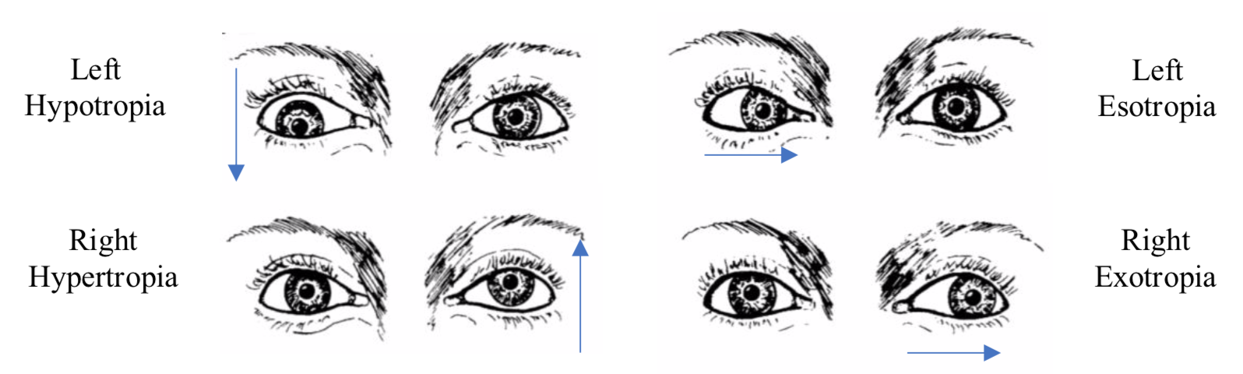
Visual deficits
Strabismus
Misalignment of visual axes
Caused by disorder in the coordination of extraocular muscles
Complications
High prevalence in children
May lead to amblyopia (decreased vision) in the strabismic eye
Lack of treatment during childhood may result in permanent vision loss
Four main types of strabismus

Slide 4
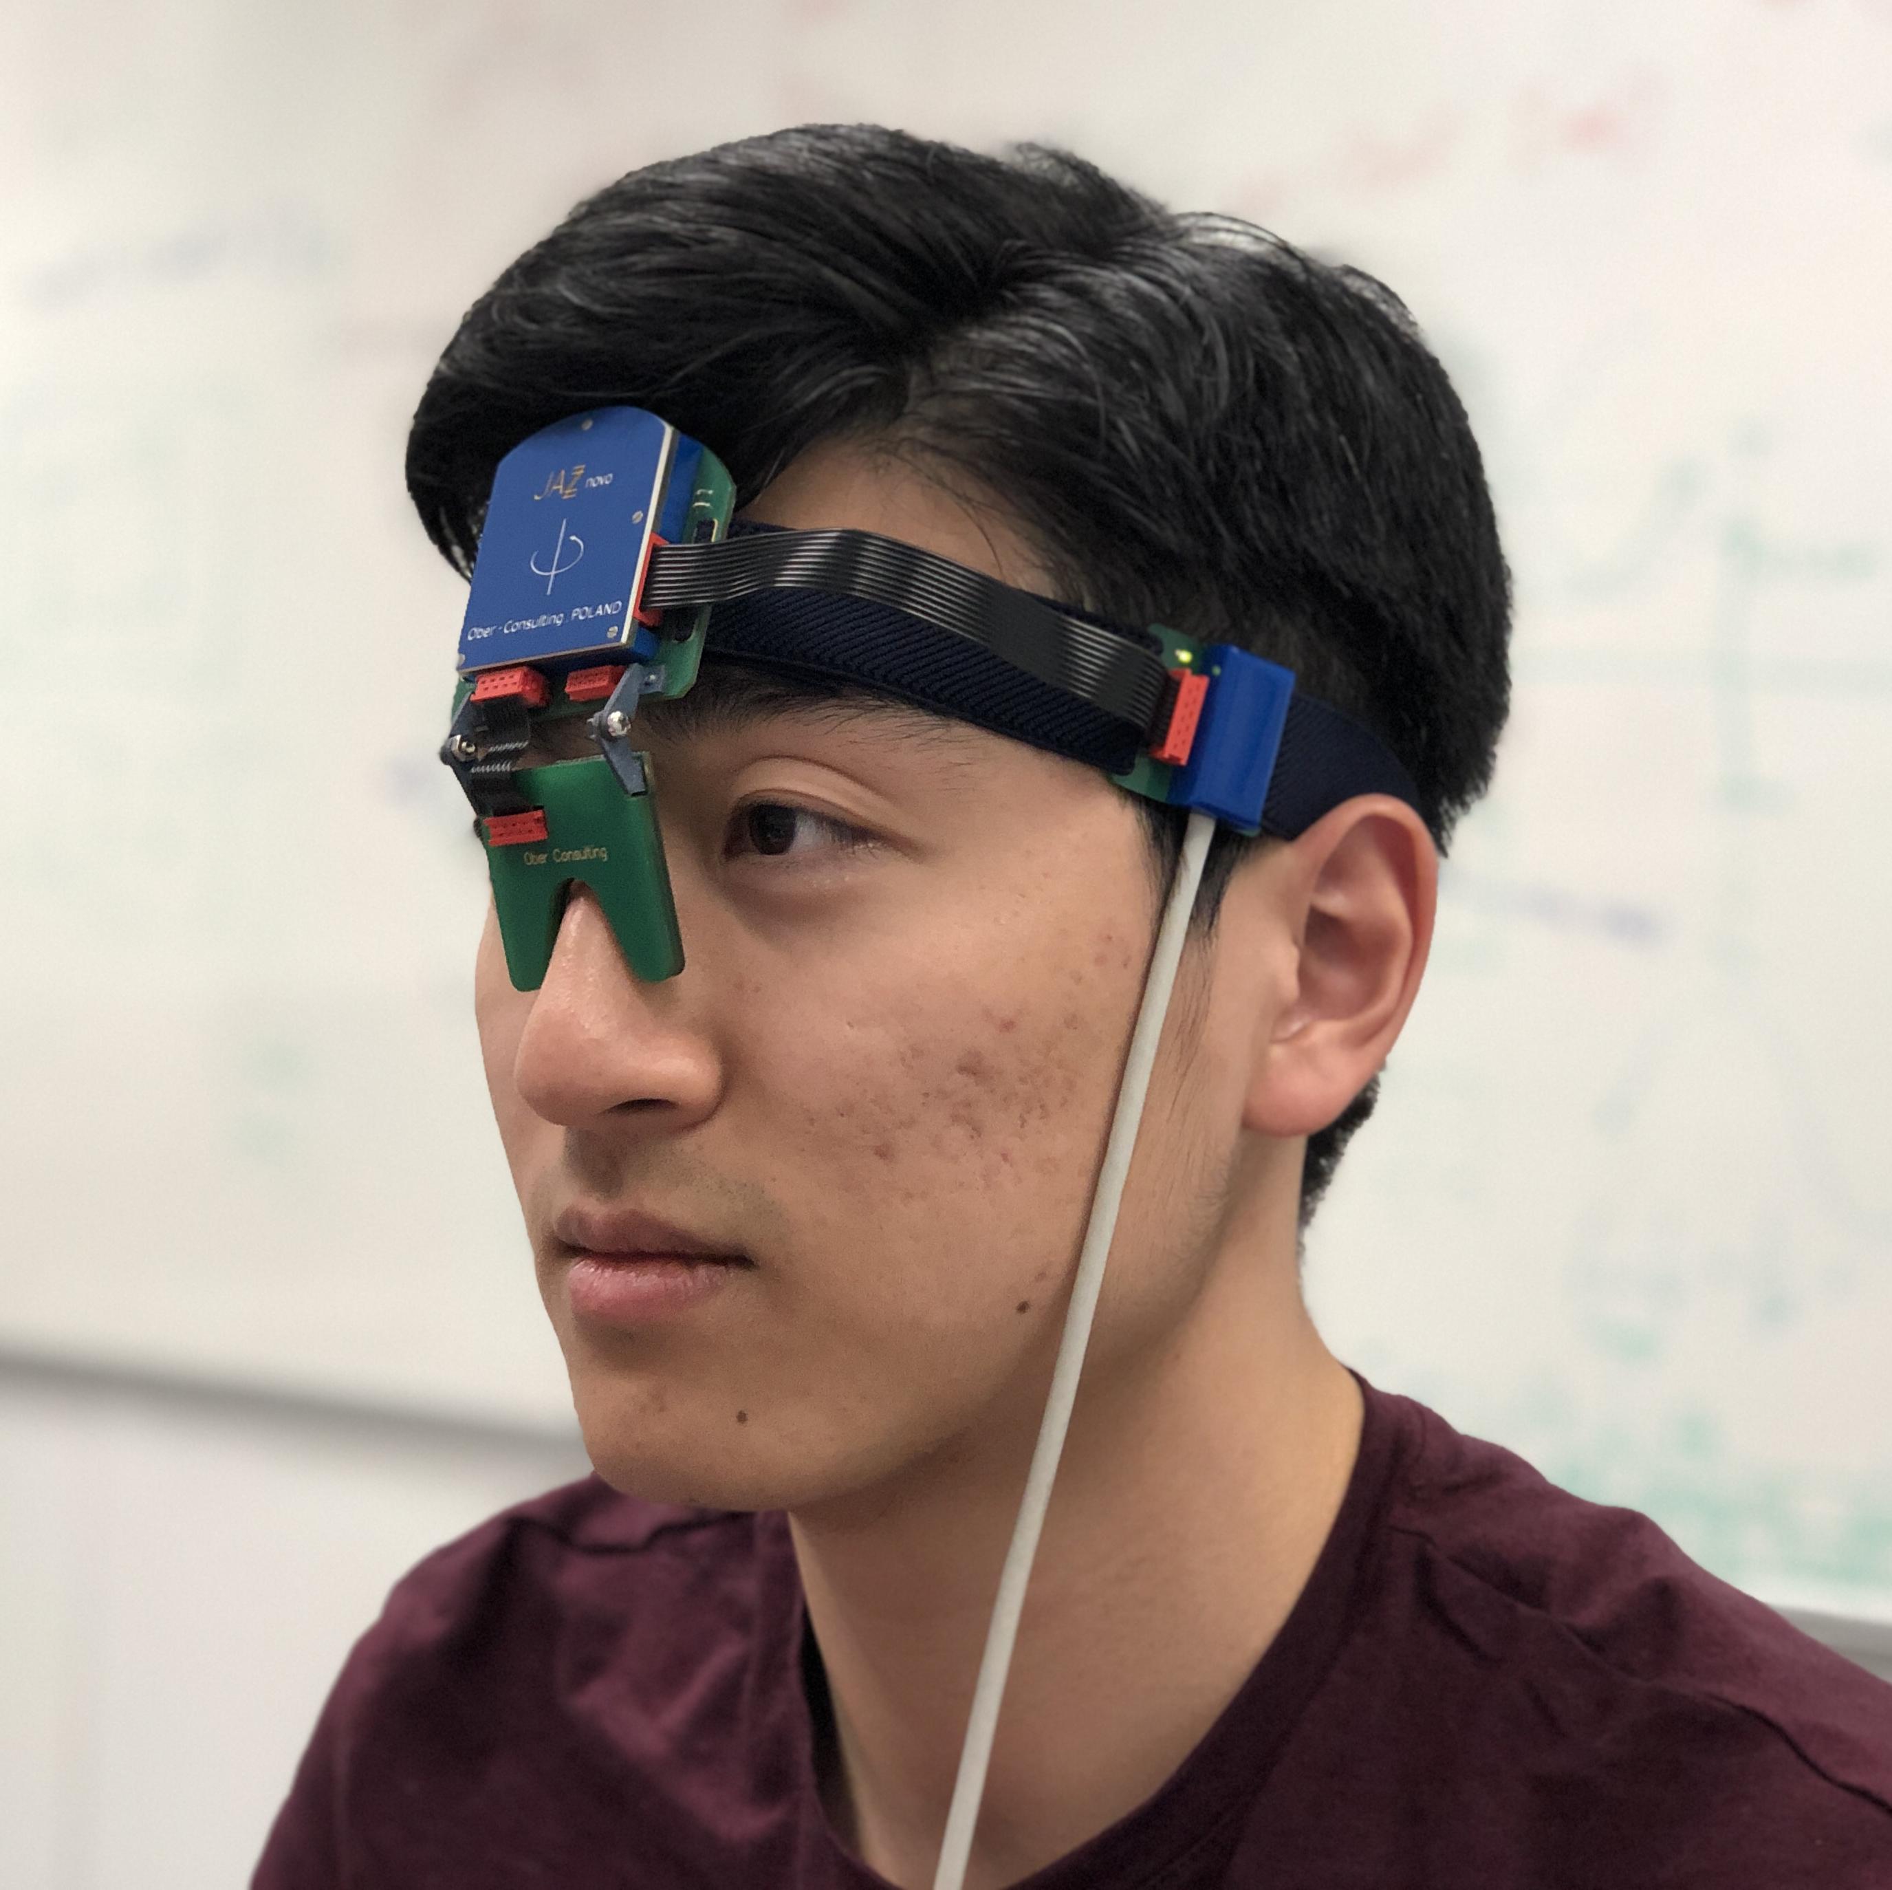
Eye-tracking system
Jazz-novo eye-tracker
Eye movements measured through infrared oculography
Infrared emitters/sensors are located between the eyes
Outputs resultant position left and right eye as a single gaze position
High sampling frequency - 1kHz
Ober Consulting Jazz-Novo eye-tracker

Slide 5
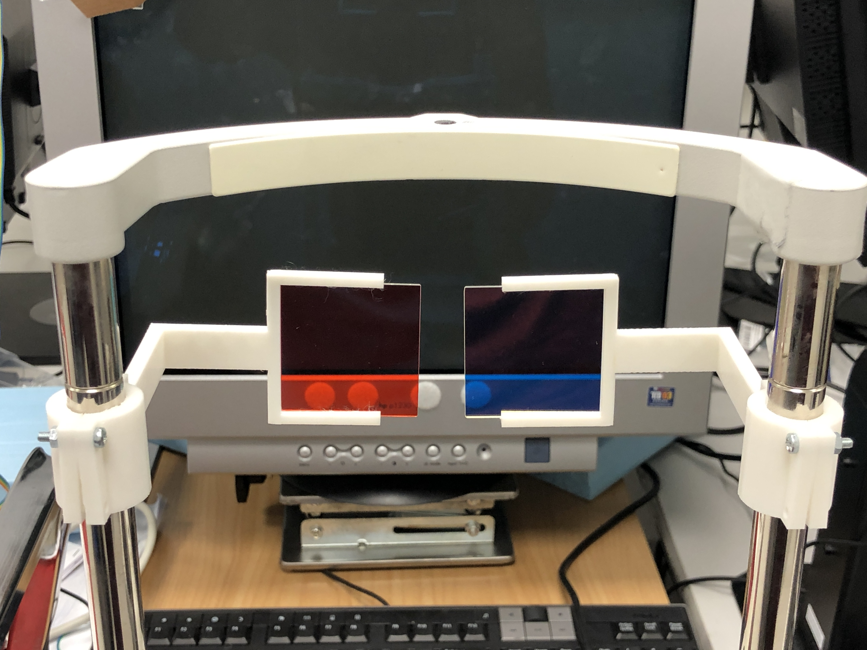
Experimental design
Characteristics of strabismus
Misalignment of visual axes
The eye used for fixation can alternate
Dichoptic presentation
Enable viewing of independent images by each eye
Analysis of visual capability of each eye
Red (Left) and Blue (Right)
Dichroic Filters

Slide 6

Experimental design
Fixation test
1 Hz alternation of red and blue stimuli at 9 locations
Filters will allow the stimulus to be visible to one eye at a time
Oscillation in gaze position may be present if the subject has misalignment in visual axes
9-point fixation test with red/blue alternations

Slide 7

Experimental design
Tracking test
Stimuli of both colours will displace horizontally and vertically
Gaze position can be analysed against the target trajectory to quantify the tracking performance
Horizontal and vertical tracking test

Slide 8
data acquisition
Calibration
4-point calibration for fixation test
2-point calibration for tracking tests (x2 sets)
Acquire relative screen coordinates
2
1
1
2
Fixation Test Calibration Points
Tracking Test Calibration Points
Notes:
To enable analysis of data points relative to screen points

Slide 9
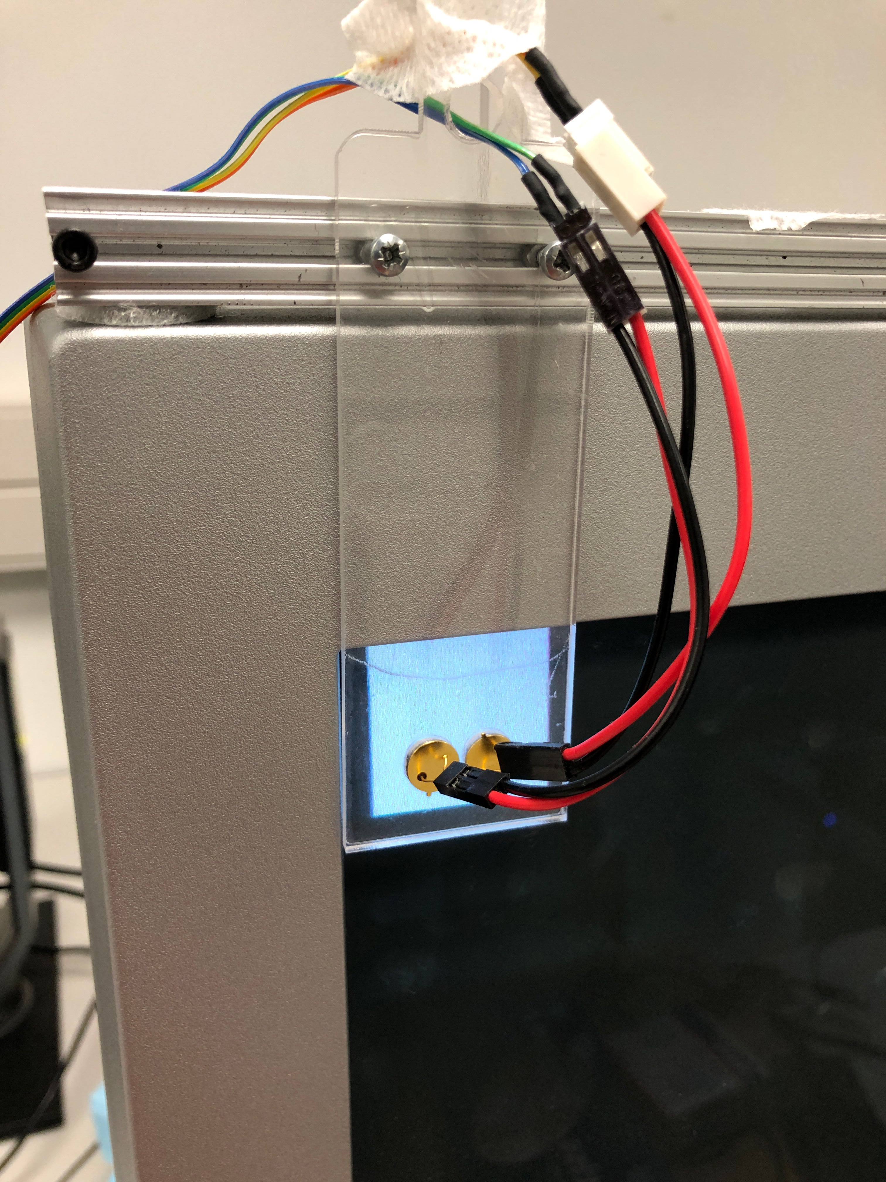
data acquisition
Trigger / Synchronisation
White square flashes at start of event
Read by Photodiode
Output trigger (Binary 1 or 0) through Arduino Uno to Biosemi ActiveTwo
Photodiode and Trigger Setup

Slide 10
data acquisition
Data Extraction
Actiview software saves as BDF file
Use Fieldtrip Toolbox in MATLAB to load BDF file
Extract X, Y, and Trigger data
Fieldtrip Toolbox
Open-source data analysis toolbox
Reads BDF Header and stores specified channels to MATLAB variables
Jazz Novo SN 1060
Biosemi ActiveTwo
BDF File
MATLAB – (Fieldtrip)
X-Y Pos. & Trigger data
Data Analysis
Data Extraction Methodology

Slide 11
Testing process
Dichroic Filter (Red-Blue)
4-point Calibration & Fixation Test
Dichroic Filter (Blue-Red)
4-point Calibration & Fixation Test
Dichroic Filter (Red-Blue)
2-point Calibration & Vertical Tracking
2-point Calibration & Horizontal Tracking
Dichroic Filter (Blue-Red)
2-point Calibration & Horizontal Tracking
2-point Calibration & Vertical Tracking
DATA ANALYSIS

Slide 12
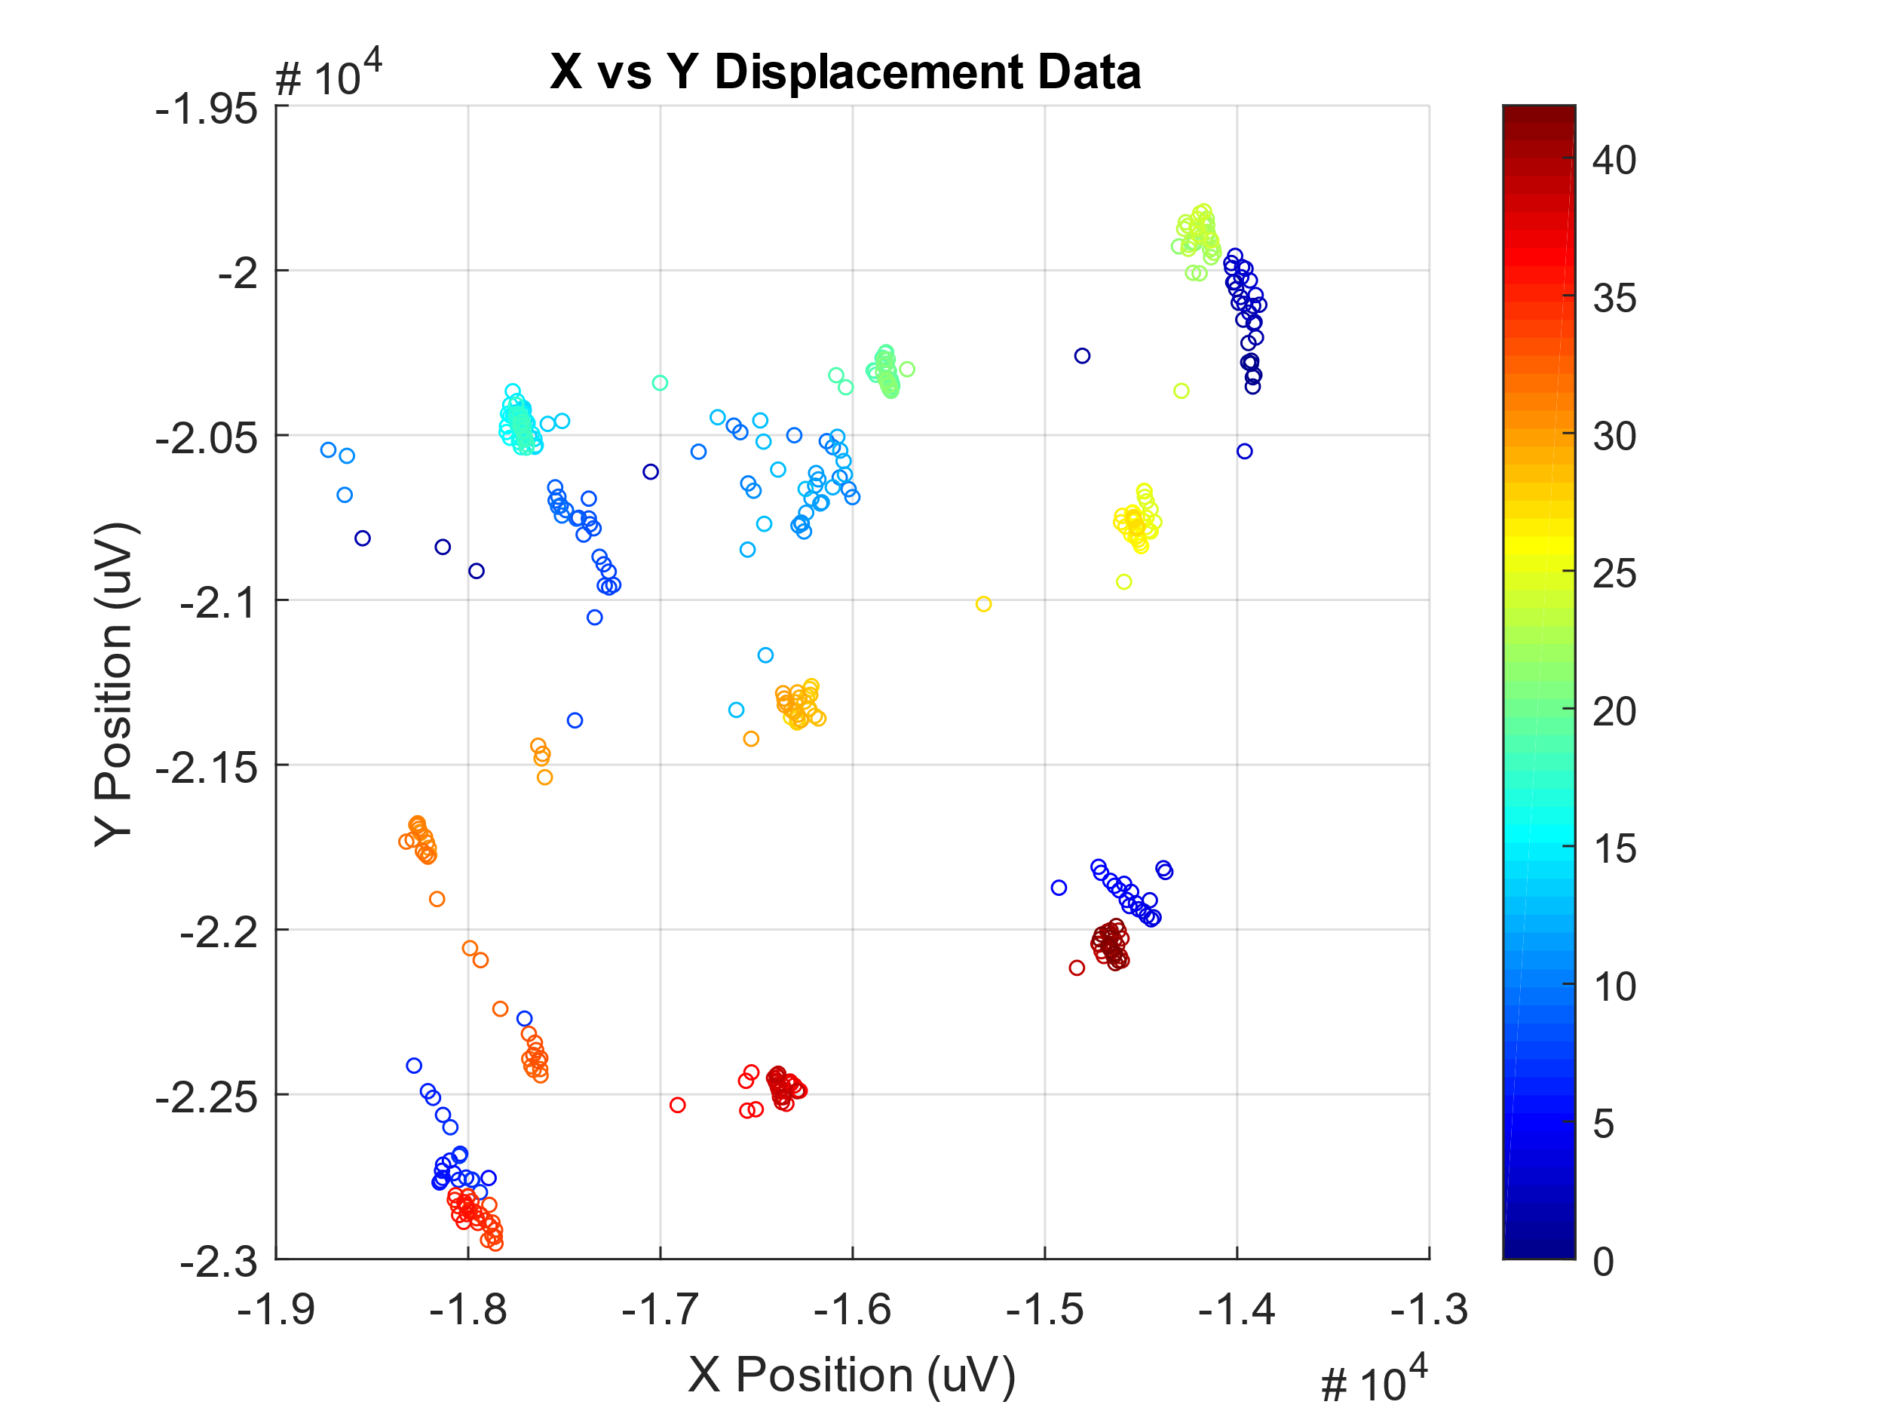
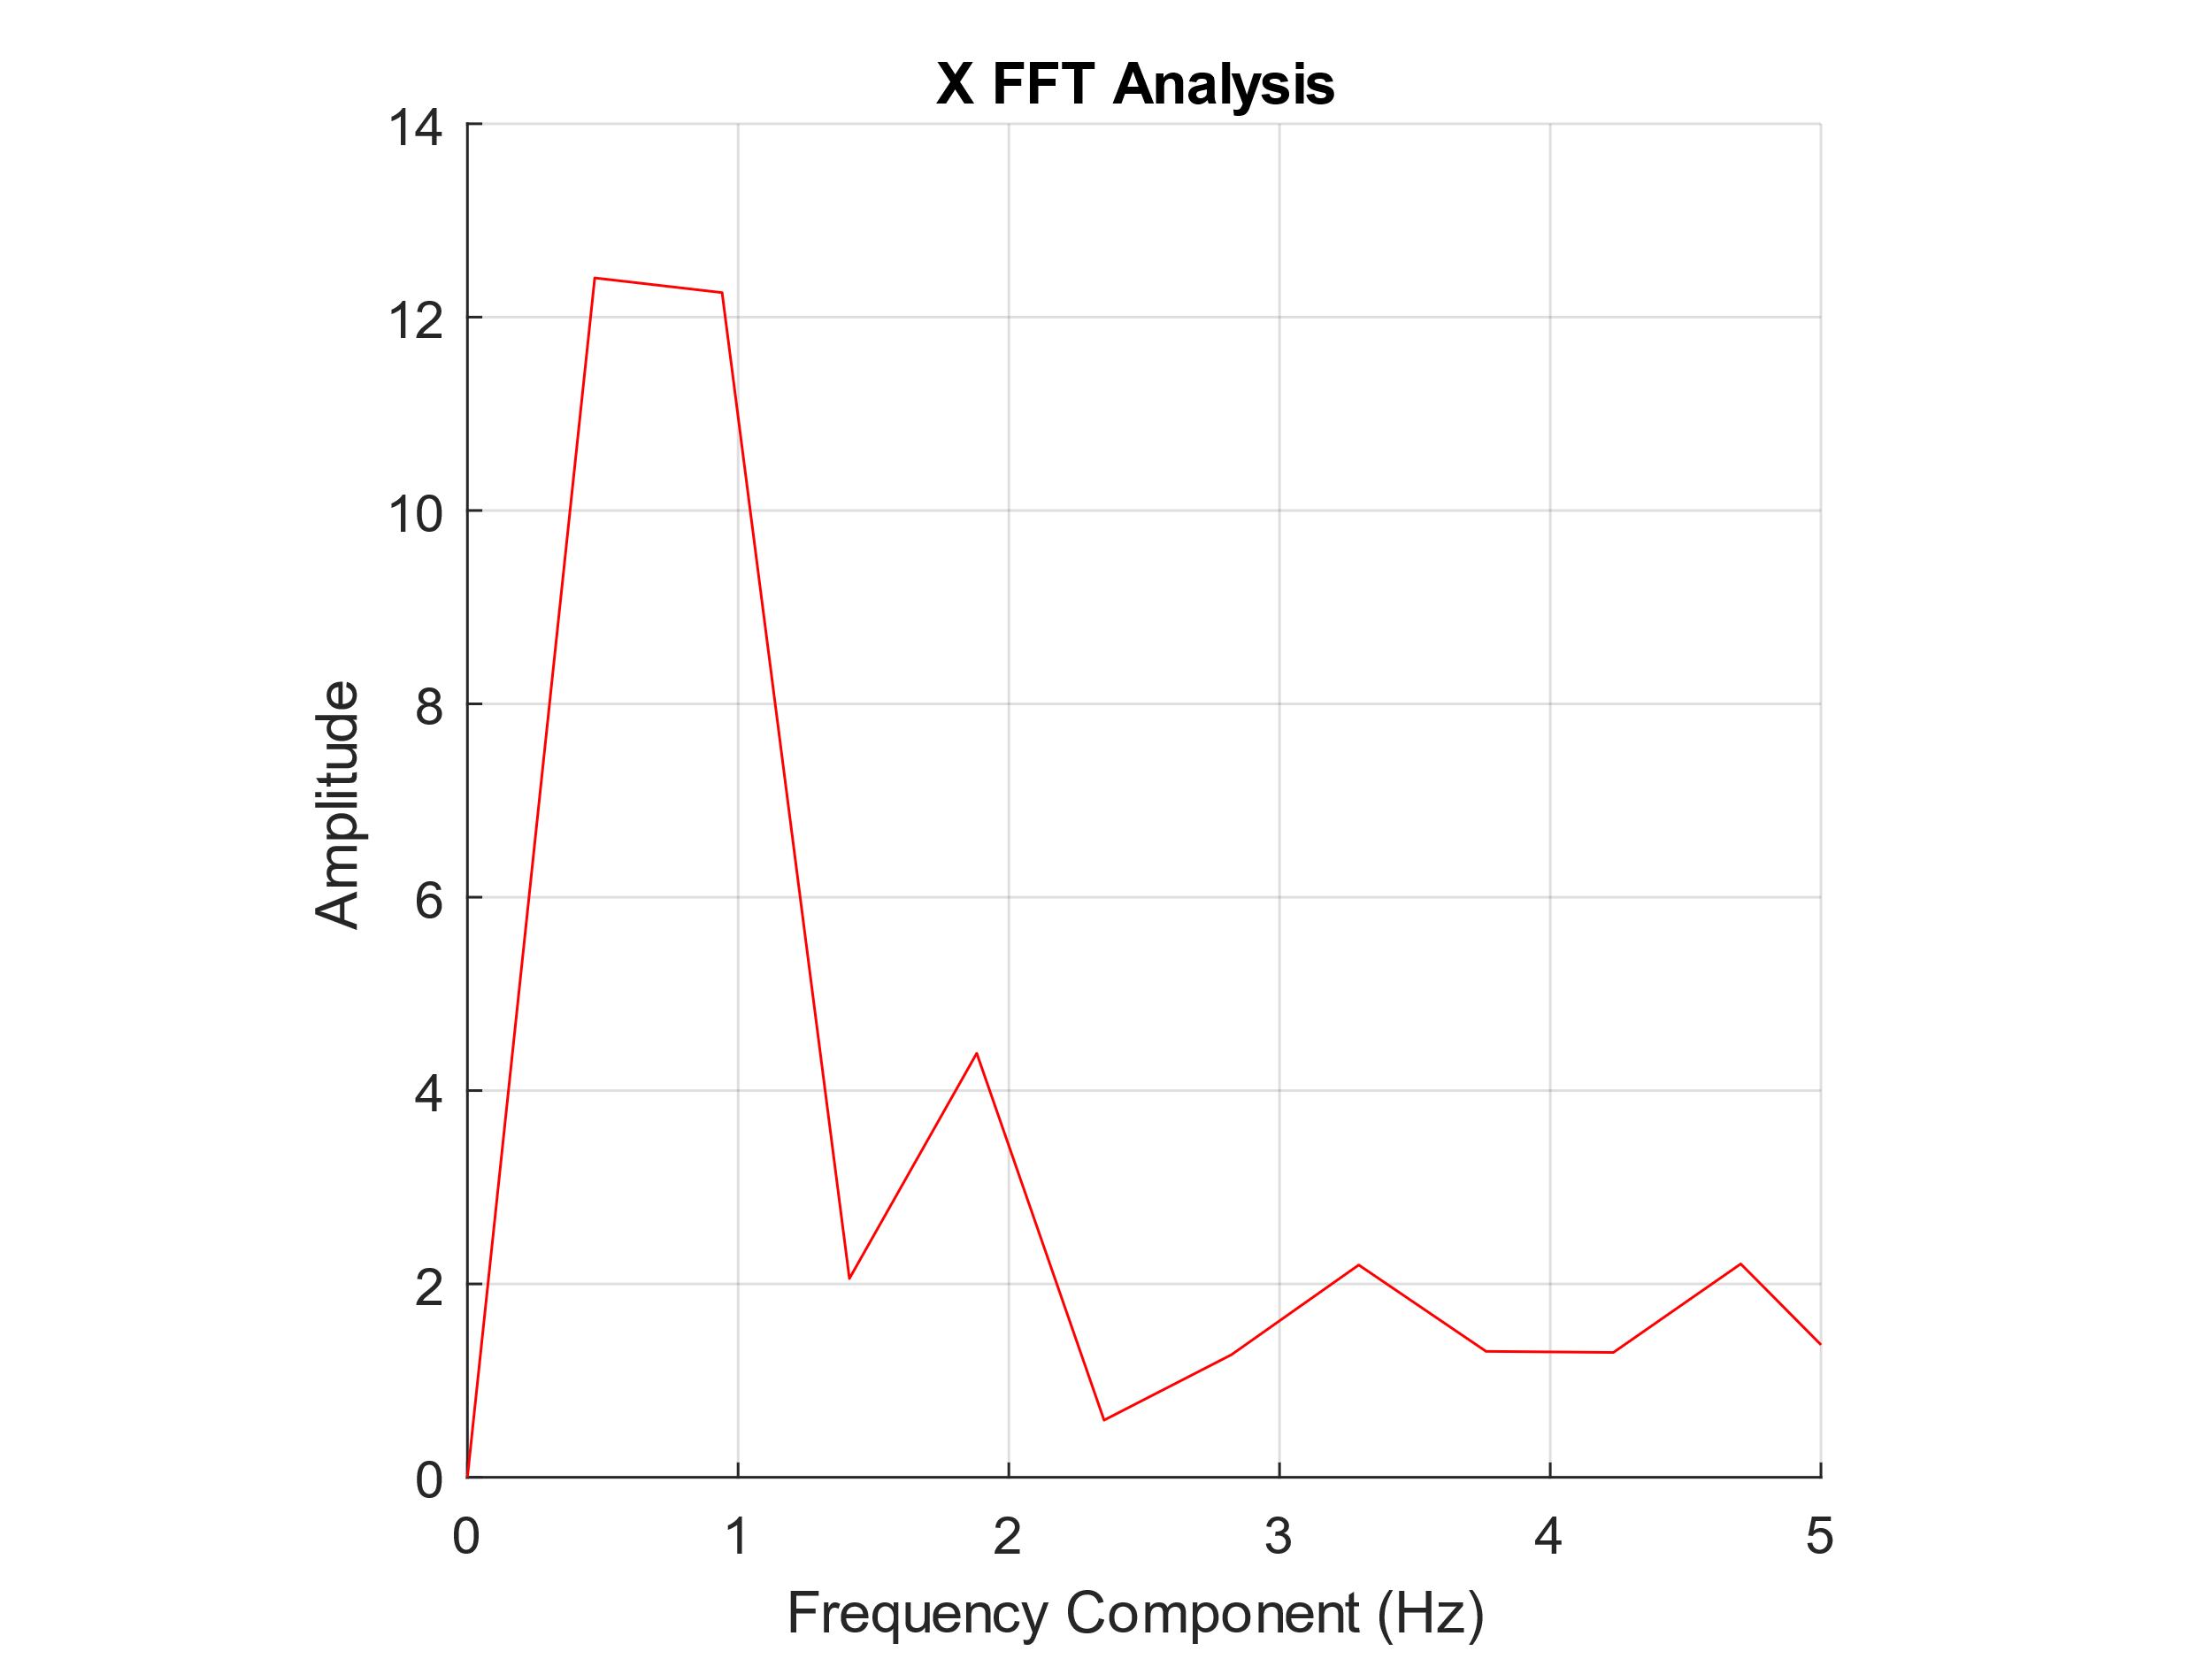
Results and analysis
Fixation Test
Mean (Accuracy) - Standard Deviation (Precision)
Fast Fourier Transform (FFT) of 1 Hz Oscillation
Relative Gains (Fixation A1/Calibration A0)
*Test data from Subject-M1608
Calibration Points
Fixation Test Data
FFT Analysis of first fixation point

Slide 13
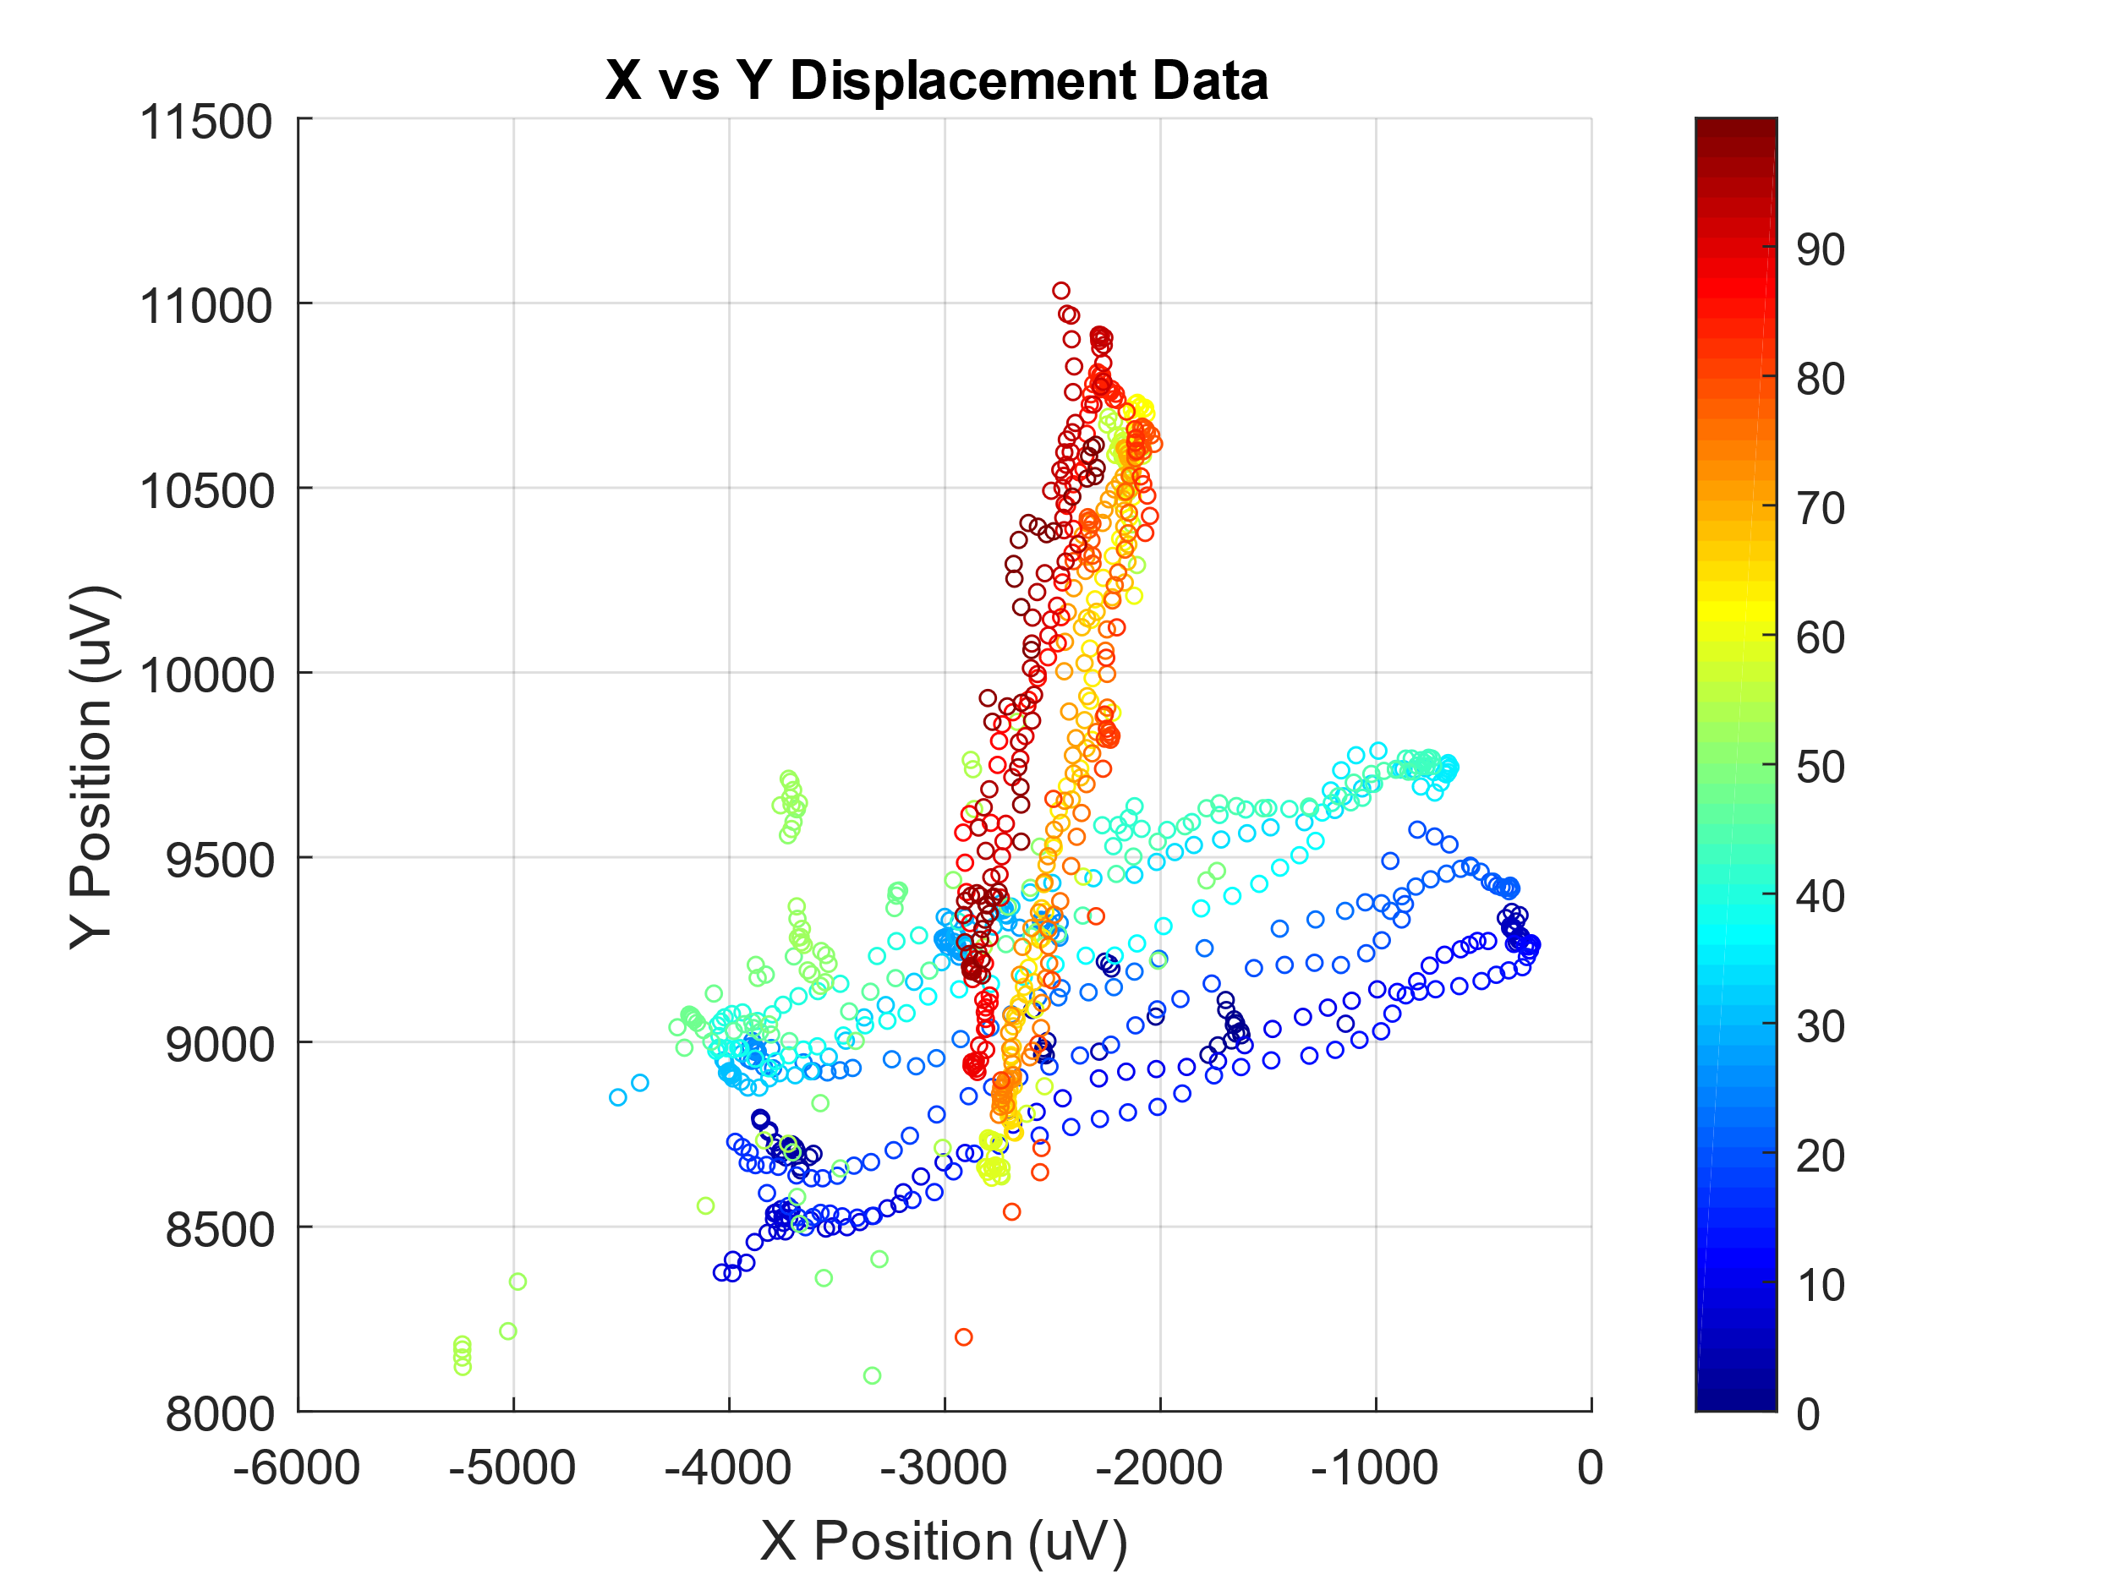
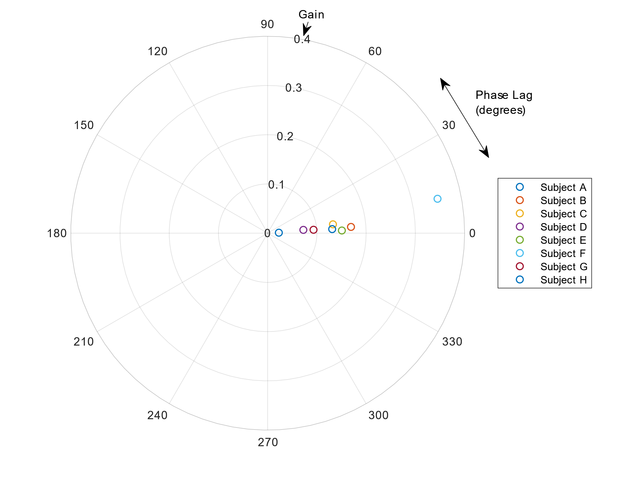
Results and analysis
Tracking Test
Quantify ‘tracking’ ability
Gain (Amplitude)
Phase (Lag)
Dominant minus Non-Dominant Eye
Calibration Points
*Test data from Subject-M1608
Tracking Test Data

Slide 14
Conclusion
Use Eye-tracking system to classify between strabismic and ‘visually-normal’ subject
Magnitude of oscillations at 1 Hz in all 9 gaze directions
Relative gain (A1/A0) used to show significantly high magnitude oscillations
Difference between DE and NDE used to illustrate tracking performance

Slide 15
Future work
Further Testing of Subjects
Strabismic subjects
‘Visually-normal’ subjects
Automated analysis via Machine Learning
Classify type and severity strabismus autonomously using training data
Less invasive method
Non-contact eye-tracker suitable for children
Mobile system
Ability to use in clinical practices

